Slide 1


Student Performance Analysis
By Cornelius Enetomhe

Slide 2

Executive Summary
Overview
This educational dashboard provides a comprehensive view of student performance across years, subjects, assessments, teachers, and demographics. This analysis offers a comprehensive overview of student academic trends, identifying key areas of strength and opportunities for improvement. We'll explore performance across subjects, assessments, and demographics to inform strategic educational enhancements.
Overall results indicate strong academic performance, improved pass rates, and consistent teaching outcomes, even as student enrollment increased significantly.

Slide 3
Key Performance Highlights
Improved Pass Rates
Consistent Scores
From 69.2% (2022) to a stable 80% (2023-2025).
Average student scores maintained academic standards.
Targeted Support Needed
Project-Based Success
Lower averages in P.E., Foreign Language, Computer Science.
Assessments yielded best student performance.
Mid-Year Dips
Manageable Failure Rate
June-July performance dips, strong year-end recovery.
Overall, 20%, requires attention with enrollment growth.
Consistent Teachers
Gender Performance Gap
Minimal variation in teacher performance.
Female students outperform males by 3.78 points.

Slide 4


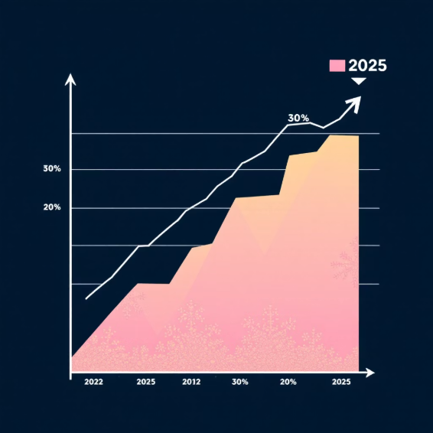

Key Insights: Progress & Stability
Pass Rate Soars with Enrollment Growth
Consistent Academic Standards
Student pass rates improved by 10.8% (69.2% in 2022 to 80% in 2023-2025), even as student population grew from 13 to 50.
Average student scores across subjects remain around the 70% mark, indicating stable academic quality.
Decreasing Failure Rate
These trends highlight effective educational strategies adapting to significant growth.
Failure rate decreased from 30% to 20% of the student population from 2022 to 2025, demonstrating positive trend.

Slide 5
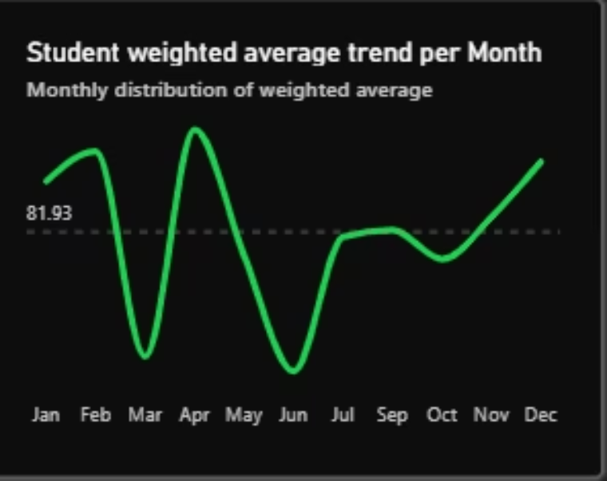
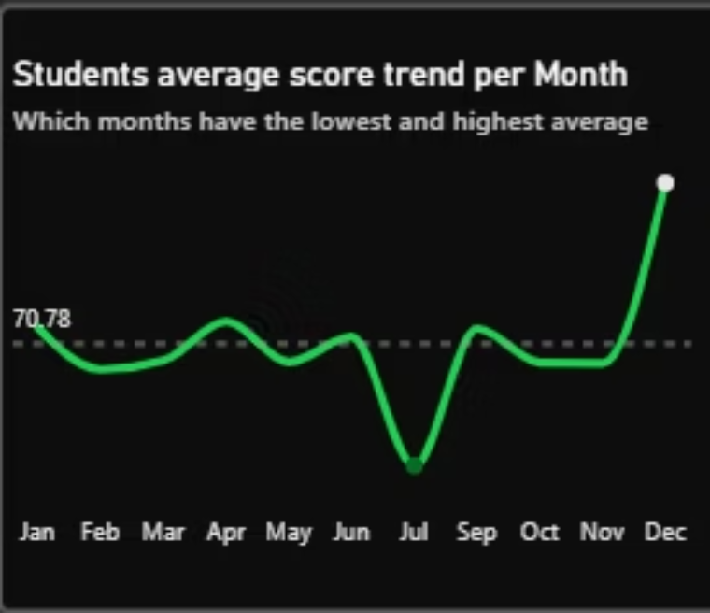
Key Insights: Monthly Performance Trends
Mid-Year Performance Dips
Performance consistently declines during June–July, followed by strong recovery towards year-end.
Periods Below Average
Majority of months show student averages below the mean, with lows in March, June, and July.
Peak Performance
Strategic Intervention
Best performance in January, April, November, and December, with Q4 as the strongest quarter.
Identifying these patterns allows for targeted interventions to bolster performance during weaker periods.

Slide 6
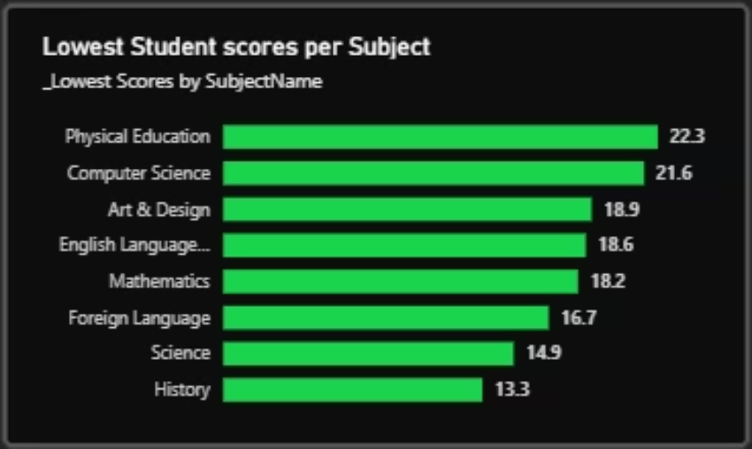
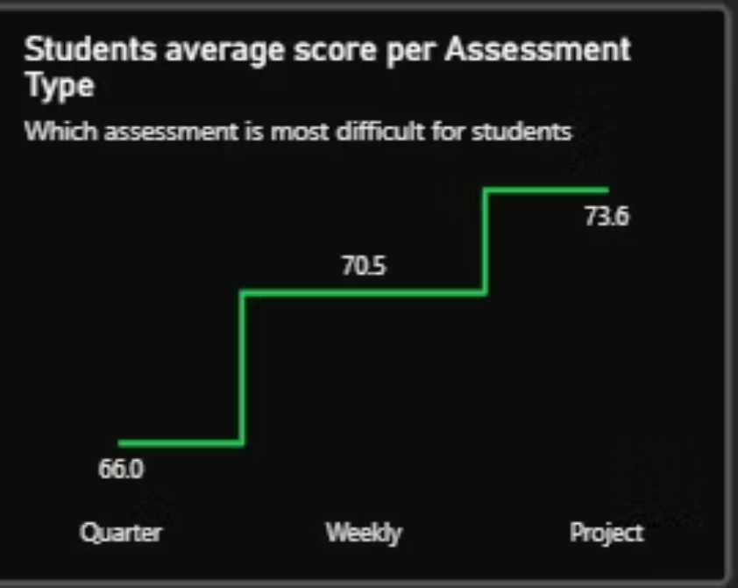
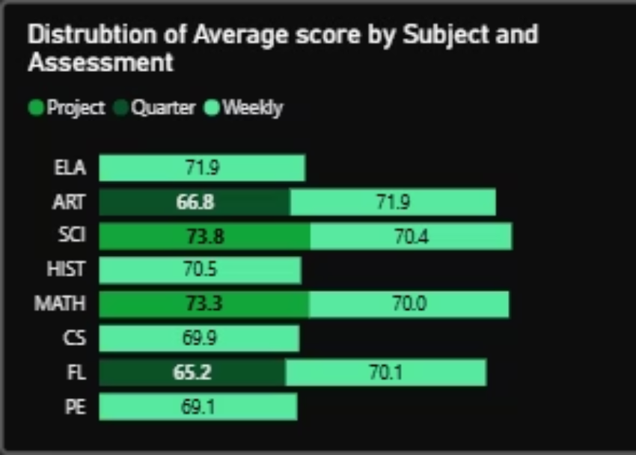
Key Insights: Assessment & Subject Performance
Project-Based Success
Project-based assessments yielded highest average scores (73.6%), favoring applied learning.
Subjects Needing Support
Quarterly Challenges
P.E., Foreign Language, and Computer Science show lower averages, indicating areas for targeted support.
Quarterly assessments recorded lowest averages (66.0%), posing the most difficulty for students.
Strongest Subjects
Insights for Curriculum
English Language, Art & Design, Science, and History emerge as top-performing subjects.
These findings inform curriculum adjustments and pedagogical approaches.

Slide 7
Key Findings: Scalability & Subject Focus
Performance Scaled Successfully with Enrollment Growth
Subject Performance Concentrated Around a Narrow Band
Student enrollment increased nearly 4x (13 → 50 students) between 2022 and 2025.
Top-performing subjects: English Language, Art & Design, Science, and History.
Pass rates improved from 69.2% to a sustained 80%, indicating effective instructional quality.
Underperforming subjects: Physical Education, Foreign Language, and Computer Science.
Average scores across subjects remained stable at ~70%.
Performance variance is narrow (≈3 points), indicating systemic rather than isolated issues.
Implication: The system is resilient and capable of supporting further growth without immediate risk to outcomes.
Implication: Targeted, subject-specific interventions can yield quick performance gains.

Slide 8

Key Findings: Assessment & Workload
Assessment Design is a Key Performance Driver
Project-based assessments deliver strongest outcomes (avg. 73.6%).
Quarterly assessments show weakest performance (avg. 66.0%).
Weekly assessments sit mid-range, suggesting assessment frequency correlates with performance.
Implication: Students perform better in applied and continuous evaluation. High-stakes assessments are primary risk points.
Mid-Year Performance Dip Signals Structural Fatigue
Performance declines consistently during June–July, followed by strong year-end recovery.
Pattern indicates academic load concentration rather than capability gaps.
Implication: Redistributing workload or introducing mid-year academic support could materially improve outcomes.

Slide 9



Key Findings: Teaching & Demographics
Consistent Teaching Quality
Minimal variance in average scores across teachers. No outlier instructors driving poor or exceptional performance.
Implication: Performance issues are systemic, not personnel-driven. Solutions should focus on curriculum and assessment design.
Manageable Demographic Gap
Female students outperform male students by 3.78 points.
Gap is consistent but not widening.
Implication: While not critical, targeted engagement strategies for male students could close the gap over time.

Slide 10





Recommendations for Improvement
Redesign Quarterly Assessment Preparation
Introduce structured revision cycles and formative checkpoints to improve performance in challenging assessments.
Prioritize Support for Lower-Performing Subjects
Focus on Physical Education, Foreign Languages, and Computer Science with targeted academic interventions.
Address Mid-Year Performance Dip
Implement academic recovery programs or workload smoothing strategies to maintain consistent performance throughout the year.
Maintain Current Teaching Model
No immediate intervention required at the staff level, as teaching quality is consistently high.

